Slide 2
Police harassment and alcohol and drug abuse is associated with poorer 6 months retention among transgender women starting ART in a clinical trial in Argentina
Inés Aristegui, P. Radusky, V. Zalazar, C. Frola, N. Cardozo, M. Duarte, S. Fabian, A. Gun, P. Cahn, O. Sued.
@FundHuesped
Share your thoughts on this presentation with #IAS2019

Slide 3
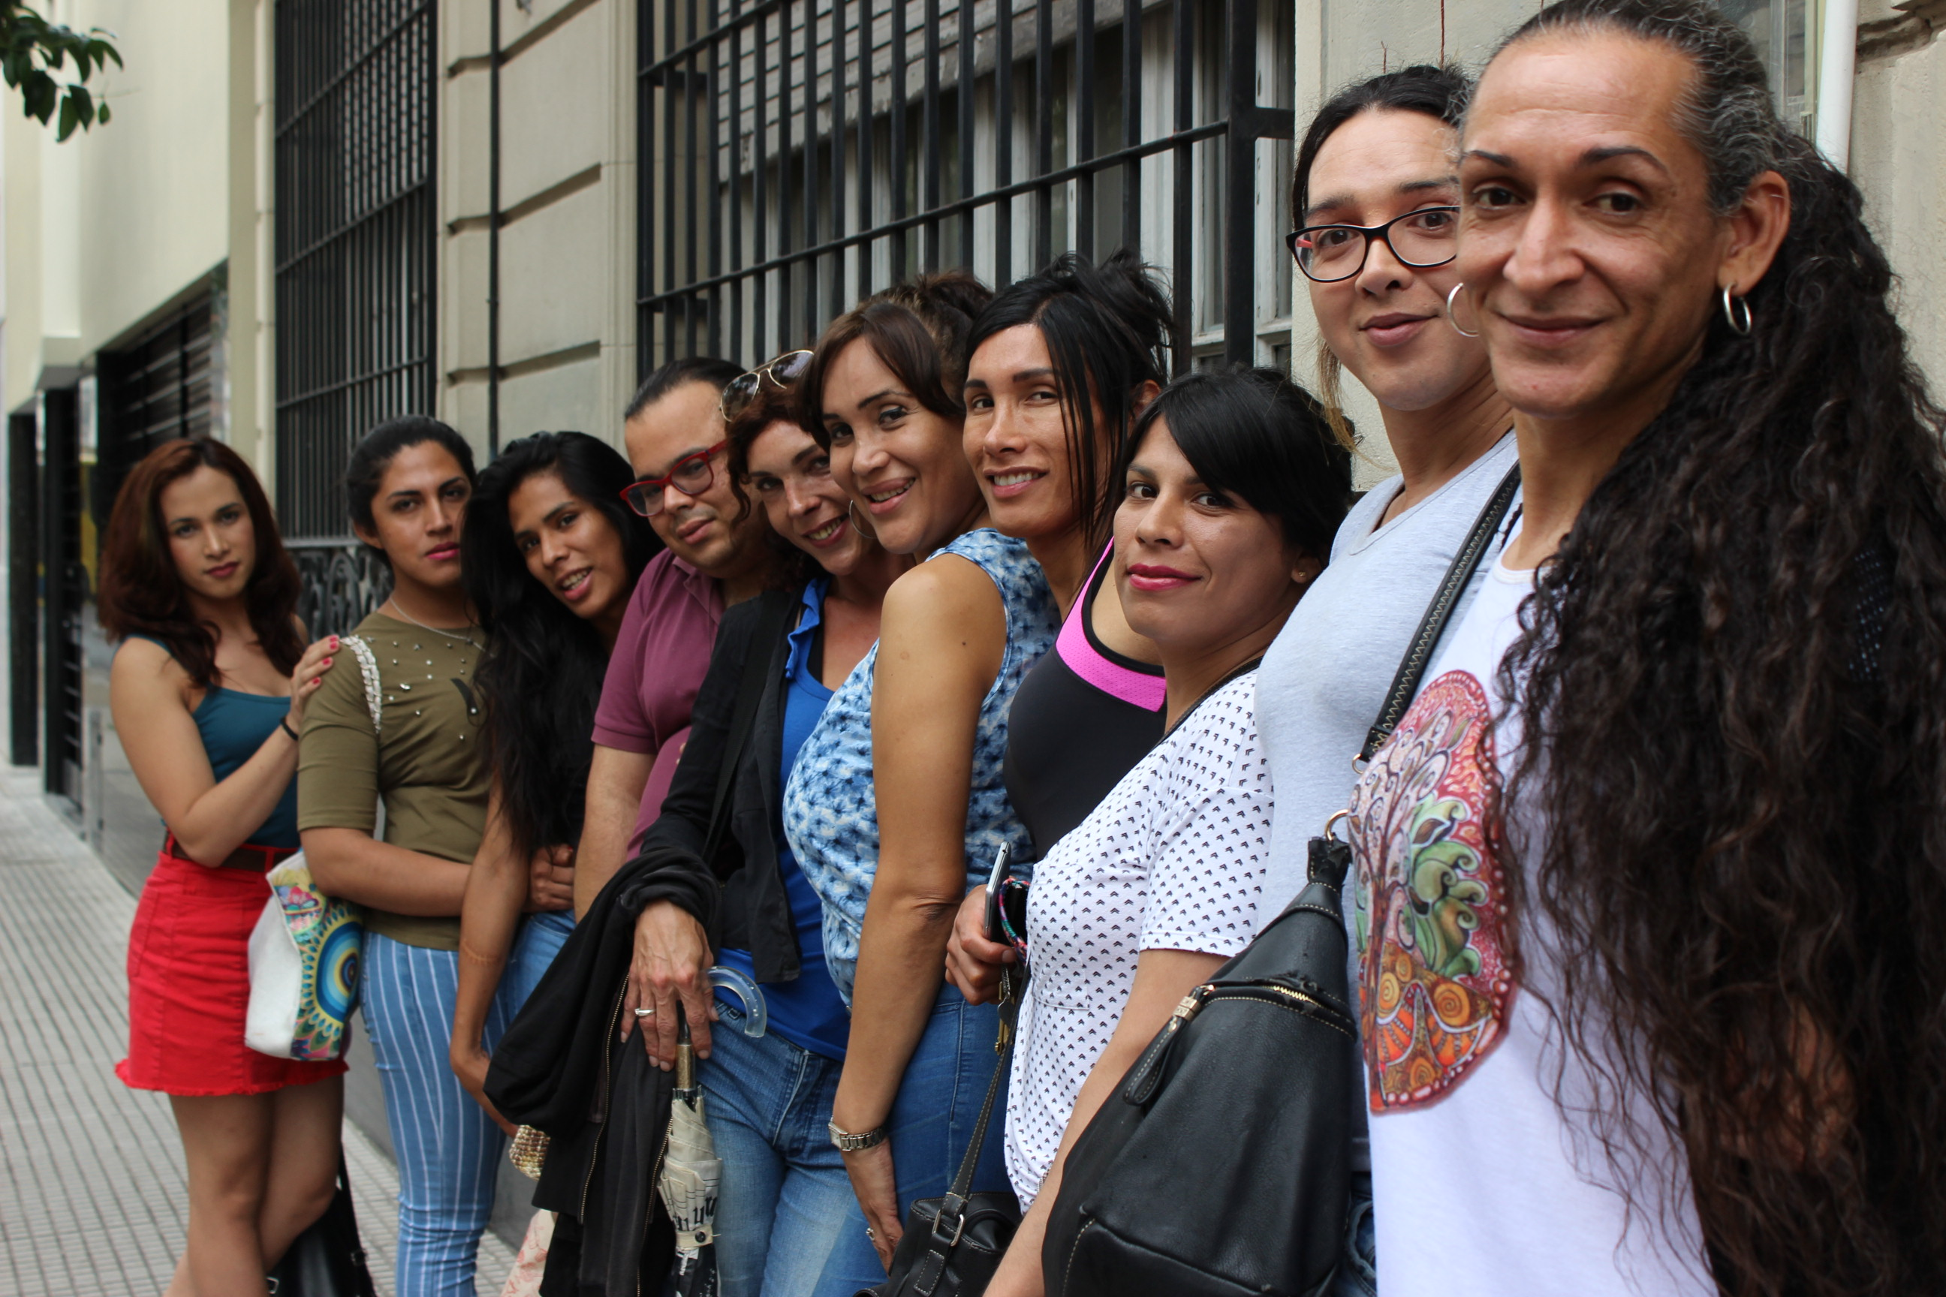
Transgender women in Argentina
MOST AFFECTED KEY POPULATION
Extremely low life expectancy
(estimated 35 years)
HIV prevalence: 34%
Syphilis: 50.4%
HPV: 97%
HCV: 4.5%
Carobene et al, 2014.
What we know
Syndemic factors act as barriers to engagement in the HIV cascade
Operario et al., 2014.
Objective: to identify psycho-social factors associated with retention in care in treatment-naive TGW in a clinical trial.

Slide 4
METHODS
PROCEDURE
Naive TGWs were offered to start (ART)
Trans-sensitive health-care service
Multudisciplinary team
Peer navigators
All staff trained
Psychosocial interviews (baseline – 24 weeks)
socio-demographic
alcohol and drug use (AUDIT, DAST)
mental health (depression, anxiety, personality traits)
experiences of stigma and discrimination
sexual behavior
FIGURE 1. Sociodemographic characteristics at baseline
SAMPLE
61 TGW - Median age: 28 (IQR: 25-32)
ª
^{c}
^{b}
ª
ª
ª
ª

Slide 5
RESULTS
FIGURE 2. Experiences of Gender Identity Stigma in different settings (last year)
At 6 months
82% (n=50) retained in treatment
77.6% (n= 39) virologically suppressed
FACTORS ASSOCIATED WITH LOSS TO CARE
Police harassment
(OR = 0.16, 95% CI 0.03-0.71)
Problems related to alcohol consumption
(t(46) = - 2.43, p =. 019)
Alcohol and drug consumption with sexual clients
(t(56) = - 3.26, p = .002)
TUPDD0106

Slide 6
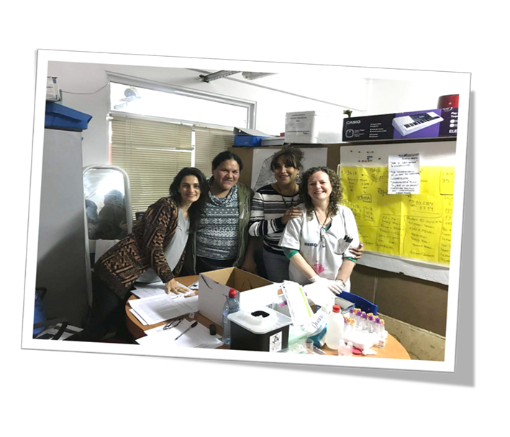
CONCLUSIONS
Retention can be improved by providing trans-competent health care. This may counteract the negative effect of previous experiences of discrimination
Consider the environment where TGW live, work and socialize, characterized by violence, substance use and discrimination, that may hinder ART scale-up.
Future interventions and clinical research should consider self-empowerment of the community, harm-reduction strategies and address multilevel strategies in order to improve TGW retention in HIV care.

Slide 7
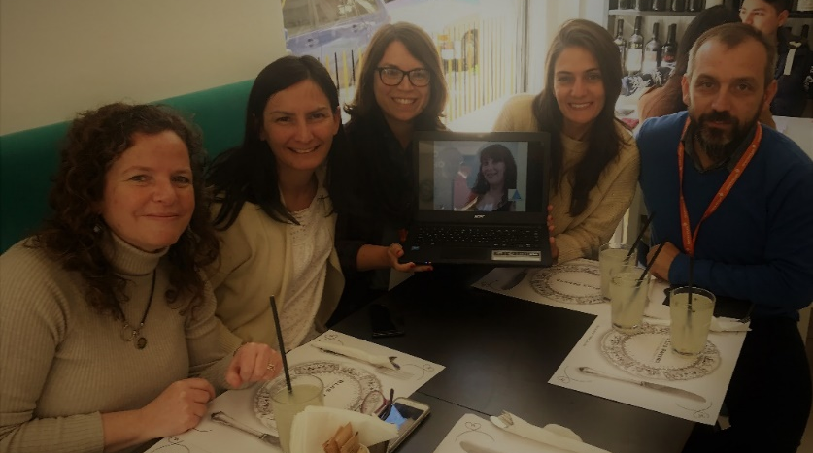
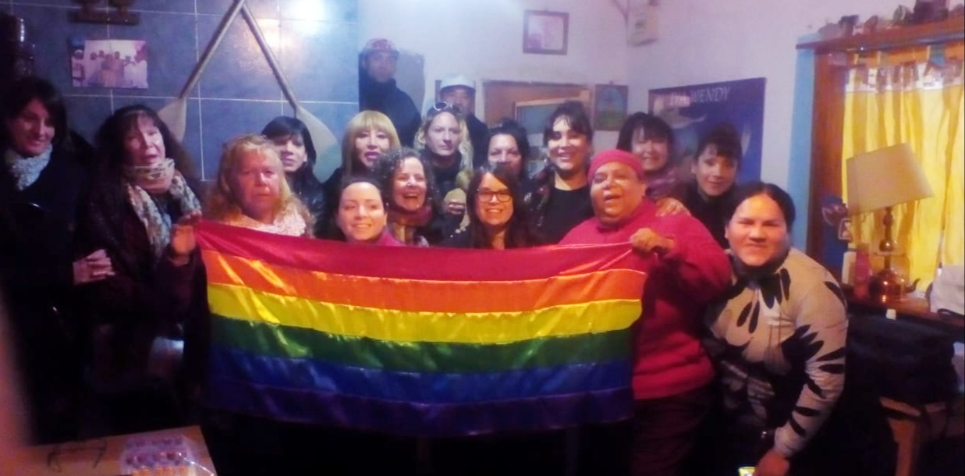
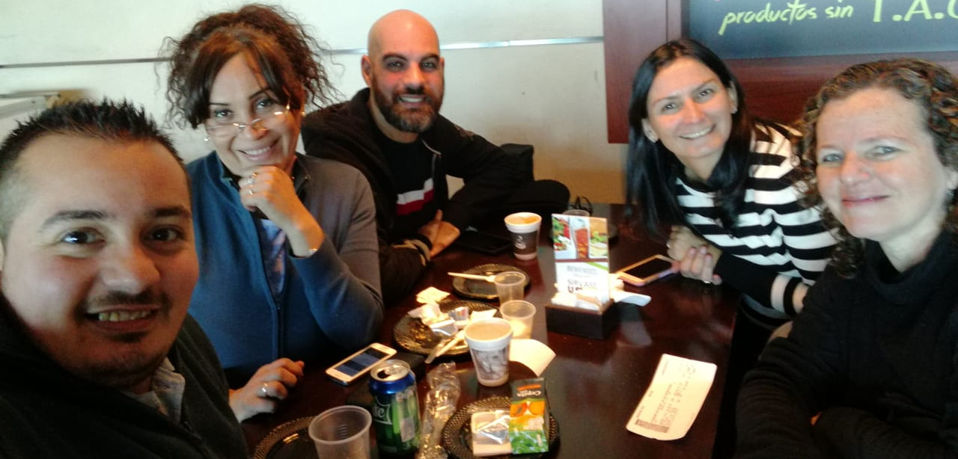
Acknowledgments
We would like to thank the representatives from trans organizations and the participants that made possible this study.
This study was supported by a grant from ViiV Healthcare,
GSK 202037
Email: ines.aristegui@huesped.org.ar

